Slide 1
Significant of Earthquakes happens using Data Science technique
BHARATHI S - 211418104040 GUIDED BY
VASUNDHARA G- 211418104305 Mrs.JENNIFER GNANADEEPAM B-211418104065 Associate Professor

Slide 2
Abstract
An earthquake is the shaking of the surface of the Earth resulting from a sudden release of energy in the Earth's lithosphere that creates seismic waves.
At the Earth's surface, earthquakes manifest themselves by shaking and displacing or disrupting the ground. So predicting the factors of an earthquake is a challenging job as an earthquake does not show specific patterns resulting in inaccurate predictions.
Techniques based on machine learning are well known for their capability to find hidden patterns in data. The machine learning model is built based on the past data related to earthquakes where the model can learn the pattern from the data and takes the consideration of the factors. The factors which are taken into consideration are the pre-processed data that is the dependency of the factors are checked in accordance with earthquake.
Comparison of machine learning algorithms are done for better prediction and performance metrics are also calculated an evaluated.

Slide 3
Review of literature survey
Topic : Earthquake Early warning system Using Ncheck and hard orthogonal Multi Target regression in Deep learning (Base paper)
Author : Adi Wibowo , Member, IEEE, C. Pratama, David P. Sahara, L. S. Heliani, S. Rasyid,Zharfan Akbar, Faiz Muttaqy, and Ajat Sudrajat
Journal name: IEEE Geoscience and remote sensing letters.
Year : 2021
PTWP and MTR tasks for the EEWS to determine earthquake source parameters in real time.
The Ncheck algorithm improves window prediction selection to reduce false alarms in multistation waveforms that have noise,and MTR with hard-shared orthogonal are proven to improve earthquake parameter determination performance.
The response time that is the prediction need to be improved.Classification and confusion matrix are not calculated.

Slide 4
Title : Earthquake predictions and scientific forecast: dangers and opportunities for a technical and anthropological perspective
Author : Edgar Tapia-Hernández, Elizabeth A. Reddy and Laura J. Oros-Avilés
Journal Name : Earth science research Journal
Year :2019
Supporting earthquake risk management with clear seismic communication may necessitate encounters with various popular misapprehensions regarding earthquake prediction.
Drawing on technical data as well as insights from anthropology and economics, this paper addresses common and scientifically-unsupported ideas about earthquake prediction, as well as the state of science-based studies regarding statistical forecasting and physical precursors.
Low computation speed

Slide 5
Title : Automatic Arrival Time Detection for Earthquakes Based on Stacked Denoising Autoencoder
Author : O.M. Saad, K. Inoue, A. Shalaby, L. Samy, and M. S. Sayed,
Journal Name: IEEE Geoscience and Remote Sensing letters
Year : 2018
The accurate detection of P-wave arrival time is imperative for determining the hypocenter location of an earthquake. However, precise detection of onset time becomes more difficult when the signal-to-noise ratio (SNR) of the seismic data is low, such as during microearthquakes.
The Algorithm can pick arrival times accurately for weak SNR seismic data with SNR higher than -14 dB.
Reliable issuing of alarms of imminent large earthquakes appears to be effectively impossible.

Slide 6
Title : Understanding post_earthquake decision on multi storey concrete building in Christ Church.
Author : F.Marquis, J.J.Kim, K.J.ElWood,S.E.Chang
Journal Name : Bulletin of Earthquake Engineering
Year : 2017
The earthquake sequence has revealed unique issues and complexities for the owners of commercial and multi-storey residential buildings in relation to unexpected technical, legal, and financial challenges when making decisions regarding the future of their buildings impacted by the earthquakes.
The paper presents a framework to understand the factors influencing post-earthquake decisions (repair or demolish) on multi-storey concrete buildings in Christchurch.
The study, conducted in 2014, includes in-depth investigations on 15 case-study buildings using 27 semi-structured interviews with various property owners, property managers, insurers, engineers, and government authorities in New Zealand.
It does not handle a complex problem.

Slide 7
Title : Simplified Seismic loss function for suspended ceilings and drywall partitions.
Author : R.P.Dhakal, A.Pourali. S.K.Sha.
Journal Name : Open Journal System
Year : 2016
.
Generalized loss functions for two important NSCs commonly used namely suspended ceilings and drywall partitions are developed in this study.
The methodology to develop the loss functions, in the form of engineering demand parameter vs. expected loss due to the considered components, is based on the existing framework for the storey level loss estimation.
The results confirm the accuracy of the proposed generic seismic loss functions.
Less accuracy with high-dimensional data.

Slide 8
Title : Towards the “Ultimate Earthquake-proof” Building: Development of an Integrated low-Damage System.
Author :S.Pampanian
Journal Name : GGEE-Geotechnical Geological and Earthquake Engineering
Year : 2015
The 2010–2011 Canterbury earthquake sequence has highlighted the severe mismatch between societal expectations over the reality of seismic performance of modern buildings.
A paradigm shift in performance-based design criteria and objectives towards damage-control or low-damage design philosophy and technologies is urgently required.
The wider acceptance and implementation of cost-efficient damage-control (or low-damage) technologies.
Learners have to wait for a response.

Slide 9
Title : A Review of Application of Data Mining in Earthquake Prediction
Author : G.V. Otari, Dr. R.V. Kulkarni
Journal Name : International Journal of Computer Science and Information Technologies
Year : 2012
Data mining techniques can also be used for prediction of these natural hazards.
16 journal articles on the subject published between 1989 and 2011 was analyzed.
The main data mining techniques used for earthquake prediction are logistic models, neural networks, the Bayesian belief network, and decision trees, all of which provide primary solutions to the problems inherent in the prediction of earthquakes, tsunamis, landslides and other micro seismic activities.
This paper also aims to encourage additional research on topics, and concludes with several suggestions for further research of checking missing values of data frame.

Slide 10
Problem Definition
The goal is to develop a machine learning model for Earth Quake prediction,to potentially replace the updatable supervised machine learning classification models by predicting results in the form of best accuracy by comparing supervised algorithm.

Slide 11
EXISTING SYSTEM
They proposed two methods and named them as picking target window prediction PTWP and multi target regression (MTR) tasks to determine earthquake source parameters.
The N check algorithm improves window prediction selection to reduce false alarms in multi station waveforms that have noise, and MTR with hard-shared orthogonal are proven to improve earthquake parameter determination performance.
Our system can provide reliable earthquake parameters. The three stations with three-component seismogram traces are represented in red, green, and blue components to form pixels in a row in one frame in a 10 s window. The sampling rate at each station varied between 20 and 25 Hz and was then normalized to 20 Hz. They used a band pass filter to minimize noise and normalize each stream by dividing its absolute peak amplitude.
The data set has high noise for 506 seismic events and has a peak SNR of less than 50 dB.

Slide 12
Drawbacks
The response time that is the prediction need to be improved
.
Classification and confusion matrix are not calculated.

Slide 13
Preparing the Dataset :
The data set contains details of all earthquakes that have happened in the last 30 days and is updated every 15 mins in the USGS website. The data dictionary.
Below are the fields included in the CSV format:
Time
Latitude
Longitude
Depth
Magnitude
magType
Nst
Gap
Dmin
Rms
Net
Id
Place
Updated
LocationSource
MagSource
HorizontalError
DepthError
MagError
MagNsT
Status

Slide 14
PROPOSED SYSTEM
Earthquakes are a natural disaster that can cause a lot of damage to both lives and properties.
The machine learning is applied to every field where the dataset can be used to learn patterns and then from that pattern the prediction can be done.
Our objective is to build a machine learning model that uses the past earthquake related dataset the data is pre-processed by using variable identification that is finding the dependent and independent variables after that the data is used to train the model by using machine learning libraries.
Different algorithms are used to compare the model and the performance metrics are calculated and evaluated.

Slide 15
Advantages
It handle complex problems, provide computational efficiency, propagate and treat uncertainties.
Damage can be controlled by early prediction of earthquakes.

Slide 16
List of Modules
Data Pre-Processing
Data Analysis of Visualization
Comparing Algorithm with prediction in the form of best Accuracy result
Deployment Using Flask

Slide 17
Feasibility study
Technical:
1.Software Requirements:
Operating System : Windows
Tool : Anaconda with Jupyter Notebook
2. Hardware requirements:
Processor : Intel Core i5
Hard disk : minimum 80 GB
RAM : 4 GB
Social:
1.Predicting the occurrence of Earthquake early can save the lives of many people and their valuable properties.
2. It also enables Government undertake precautionary measures so that the effects and consequences are minimized.

Slide 18
Economic:
Accuracy,Precision and Recall are calculated using the following predefined formulas:
Accuracy = (TP + TN) / (TP + TN + FP + FN)
Precision = TP / (TP + FP)
Recall = TP / (TP + FN)
Where,
TP -> True Positives
TN ->True Negatives
FP ->False Positives
FN ->False Negatives
Score=2*(Recall*Precision)/(Recall+Precision)
Accuracy works best if false positives and false negatives have similar cost.

Slide 19
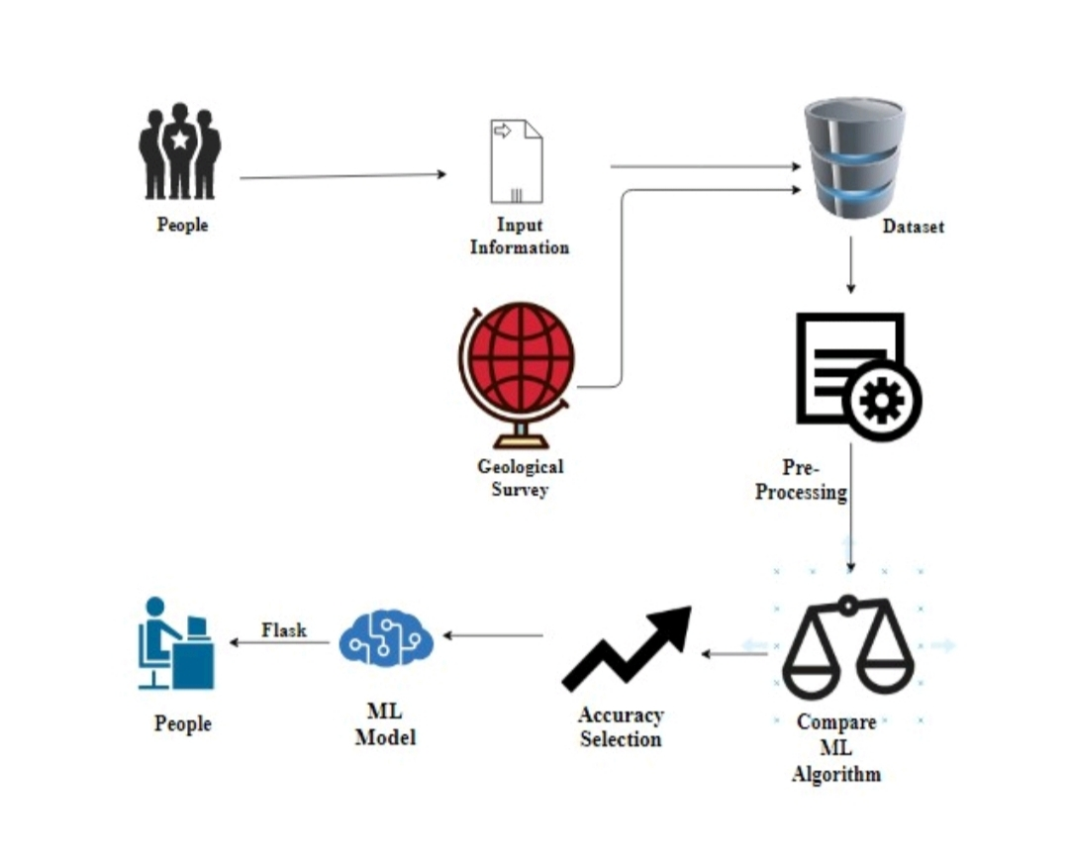
System Architecture
Input:
1.Latitude
2.Longitude
3.Magnitude
4.Time
5.Depth
6.Location Source
7.HorizontalError
8.DepthError
9.MagError
10.Magsource
Output:
0
(No Earthquake)
1
(if Earthquake occurs)

